Slide 1

DriverPass System Analysis
Kris Ferguson

Slide 2

System Requirements
Functional-
The system shall generate and display comprehensive audit reports for administration.
The system shall allow IT officers to have full administrative access over all user accounts.
Non-Functional-
The system should be updated at least as frequently as the DMV updates their policies.
This system should be a web application with cloud service to provide automatic scaling and reduce hardware constraints on the Client.
Notes:
The functional requirements for this system include the generation and displaying of comprehensive audit reports for administration, and the system shall allow IT officers to have full administrative access over all user accounts. These requirements meet the clients needs because the owner specifically requested the ability to view audit reports, these reports will track who did what and when to allow full auditability for the client. The client also requested modularity for future system expansion and voiced recognition for the need of an IT officer to handle that, dmv updates, password resets, etc. This system will enforce RBAC, so giving IT admin level access will allow the IT officer to meet these expectations. The non-functional requirements include the updating the system to at least match the frequency of DMV updates, and the system should be a web application with cloud service to provide automatic scaling and reduce hardware constraints. These requirements meet the clients goal of helping more students pass their driving test, to do that the system must be up-to-date with all DMV rules and policy changes. The client does not have the hardware, team, experience, or want to maintain the servers for this system, as they want to focus on the business side. Having the system be cloud hosted meets this goal by offloading that responsibility to the cloud.

Slide 3
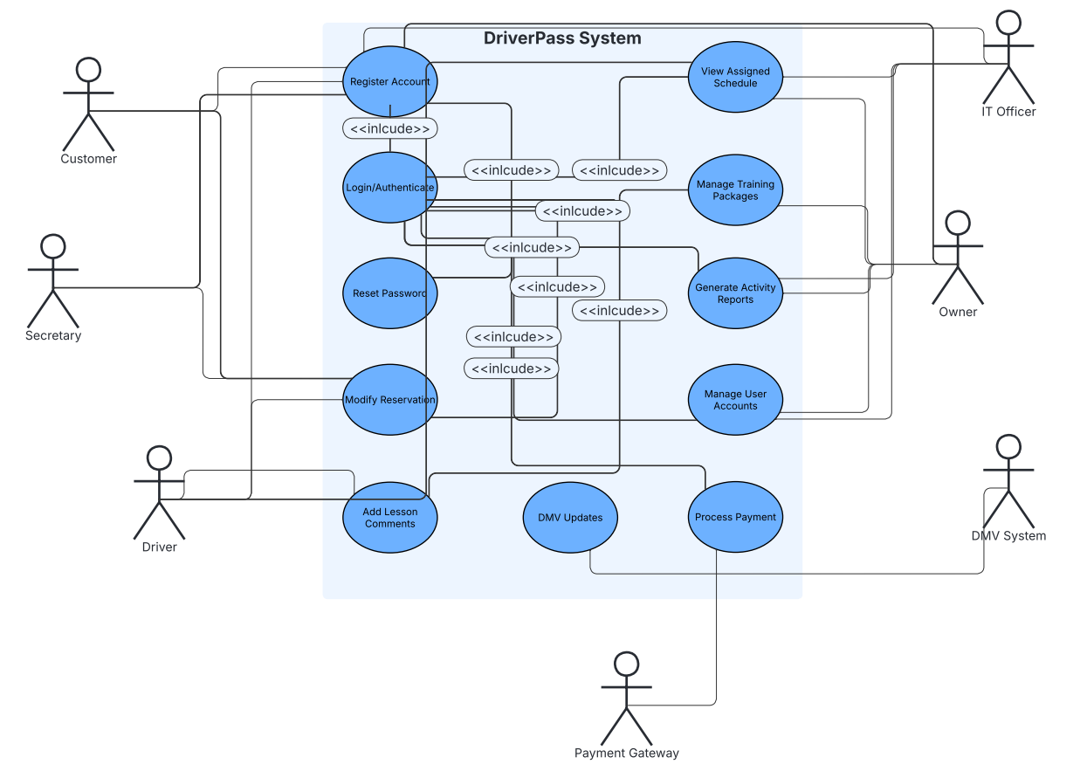
Use Case Diagram
Notes:
This use case diagram is a visual representation of how the different users will interact with different parts of the system. Users at every level will need to register an account and have an authenticated login to interact with every part of this system. This diagram shows how the requirement of the IT officer will have admin level access by showing their interaction with generating activity reports, manage training packages, modifying reservations, reset passwords and viewing assigned schedules. A secretary is able to modify reservations as well for customers over the phone. Payment gateway is able to process payment, and DMV System is able to push updates.

Slide 4
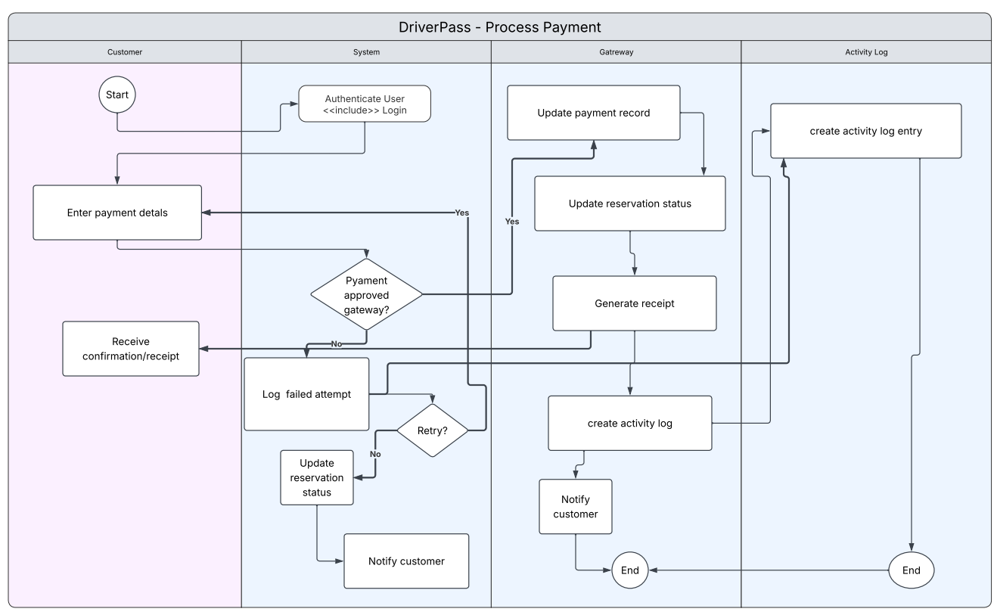
Activity Diagram
Notes:
This is the activity diagram for the processing of payments for the driver pass system. The activity starts once the customer signs in and is authenticated, the customer then enters their payment details, then the payment gateway checks if the payment is approved. If the payment is not approved the failed payment is logged and the customer is asked to retry, if the customer wants to retry the payment, then the process is started again at the payment gateway approval step, if the customer does not wish to retry the payment, then notification of failed payment is sent to the customer. Once the payment is successful customers payment record is updated, reservation status is updated, a receipt is generated and sent the customer, the timestamped activity is logged and the customer is notified, the logged activity is then sent to the ActivityLog for auditing.

Slide 5
Security
The user will need to enter a case-sensitive Id and password to gain access to their account page.
The system will encrypt data using HTTPS and TLS protocols, SSL/TLS and OAuth 2.0 or similar for server and client verification, and input validation and cryptographic hashing for data integrity.
In the event of a brute force attack the account should automatically lock and require admin login to unlock and implement rate limiting.
If a user forgets their password then a link should be sent to their email to reset it.
Notes:
Strict input validation is the backbone of a secure system. All users personal information will be encrypted and all credit card information will be tokenized, meaning that information will never be stored on your servers. Case-sensitive Id and passwords and role-based access control help decrease the chance people get access to information they should not have. The system will err on the side of caution, suspicious activity and violations will trigger automatic account lockouts that require admin approval to unlock, and rate limiting to prevent Denial of Service. In the event a user forgets their password a link will be automatically sent to their personal email to reset it.

Slide 6
System Limitations
As a web and cloud-based application there are no native mobile applications or offline-capable desktop clients.
Significant customization requires developer involvement and is not available as self-service feature.
Initial scope does not include advanced accessibility features.
System does not currently include physical hardware control or non-training logistics such as key management, fuel tracking, and maintenance scheduling.
System will be subject to cloud providers outages or the clients internet connection.
Initial version lacks advanced features such as AI integration, detailed analytics dashboards, or third-party calendar applications
Notes:
All system will have limitations, ours included. Limitations include: due to the web and cloud-based nature of the system there will not be an option for a native mobile app or offline capabilities for desktop clients, the clients lack of a dedicated development team will limit application customization, current iteration lacks accessibility features, as of now there is no functionality in the system to track the clients physical hardware including keys, fuel, and vehicle maintenance, cloud providers are not infallible and this system will be subject to any outages, and finally the current version lacks any advanced features including integration of AI, detailed analytics, or third-party calendar applications.

